Slide 1
RAPD PCR Random amplification of polymorphic DNA
By
Assist. Prof. Dr. Ali Aldeewan

Slide 4
PCR

Slide 5
he

Slide 9
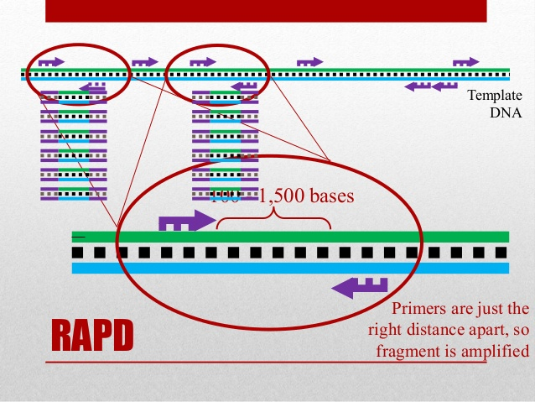

Slide 11
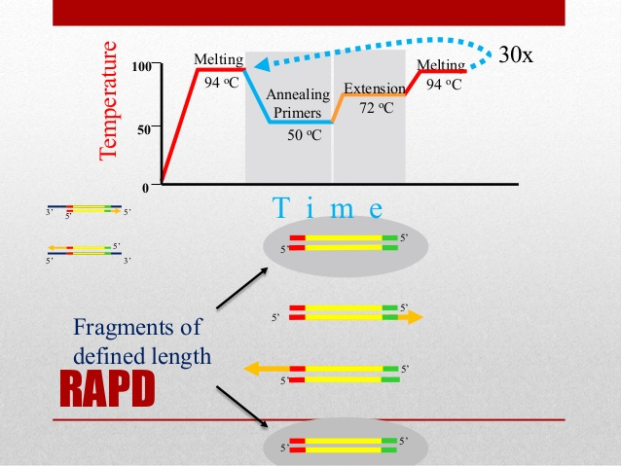

Slide 13
Sample 2
Sample 1
Sample 2

Slide 15
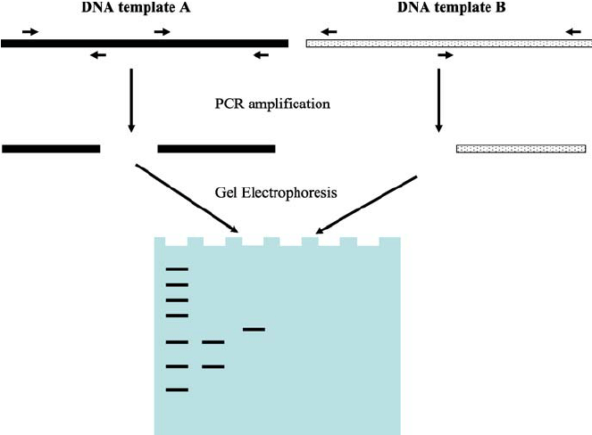

Slide 18
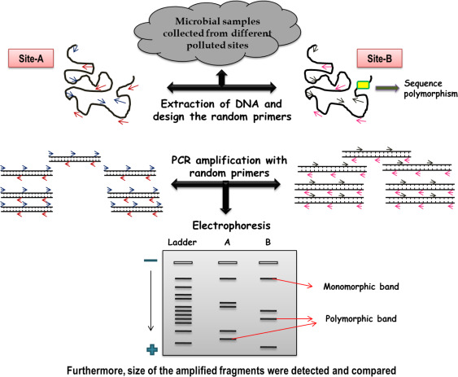

Slide 19
